Slide 1

Flow Control

Slide 2
What is flow control?
By using key words, flow control alters the flow of a program
These conditionals are based on a Boolean expression (true or false)

Slide 3
If Statement
The if keyword is used to check if an expression is true. If it is true, a statement is executed.

Slide 4
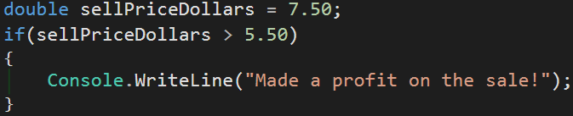
What an if statement looks like:

Slide 5
If, Else If, Else Statement
if-else is used in the case of if an expression is false, do the else part of the if-else statement.

Slide 6
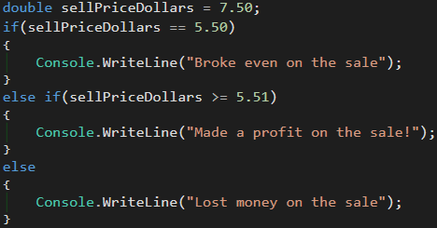
What an if-else statement looks like:

Slide 7
Switch Statement
A switch statement tests a value (switch) from the variable or expression against a list of values (cases).
If the switch value matches a case value, the code following the case value is executed.
The default case is executed if none of the other cases are met.

Slide 8
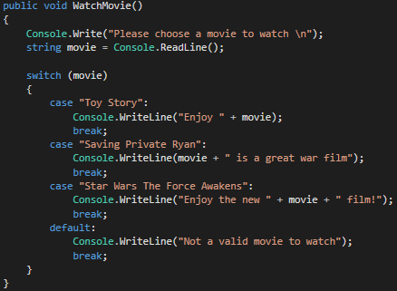
What a switch statement looks like:

Slide 9
Difference Between If and Switch
If statement is used when there is a Boolean expression (a true/false selection). Essentially, a series of Boolean checks.
A switch-case is used when a specific value is desired.
If you see yourself using an if statement to check if values are equal to each other, then it makes more sense to use a switch-case

Slide 10
Break
To terminate a block of code in a switch statement, while loop, or for loop, there is the break keyword.
The break statement can be used to break out of an endless loop.
In the case of a switch, it can be used to break out of the switch-case when a value is satisfied.
The break keyword will exit a loop or code block completely.

Slide 11
What the break keyword looks like:

Slide 12
Review Questions
What is the difference between an if statement and switch-case?
Does an if statement need to include ‘else’ in order to be valid?
Does a switch-case need to have a ‘default’ in order to be valid?
When is it appropriate to use the break keyword?

Slide 13
Assignment
Build a “Choose Your Own Adventure” story
Using flow control, you will decide what path to take your story based on certain circumstances.
Use switch-cases and if-else statements to create a console application that will allow a user to pick the path of their own adventure game.

